Slide 2
Why study abroad?
Enhance your marketability
Instill cultural competency
Challenge yourself
It’s an opportunity of a lifetime!
Notes:
You’ll gain transferrable skills that are attractive to employers, such as adaptability, initiative, experience working with individuals from different cultures and backgrounds.
Cultural competency is one of the pillars of public affairs at MSU and the best way to experience it is by immersing yourself in a different culture.
You will challenge yourself in new ways that you simply can’t experience in the familiar environment of MSU.
Whether it’s short-term or long-term, education abroad is truly an experience of a lifetime.

Slide 3
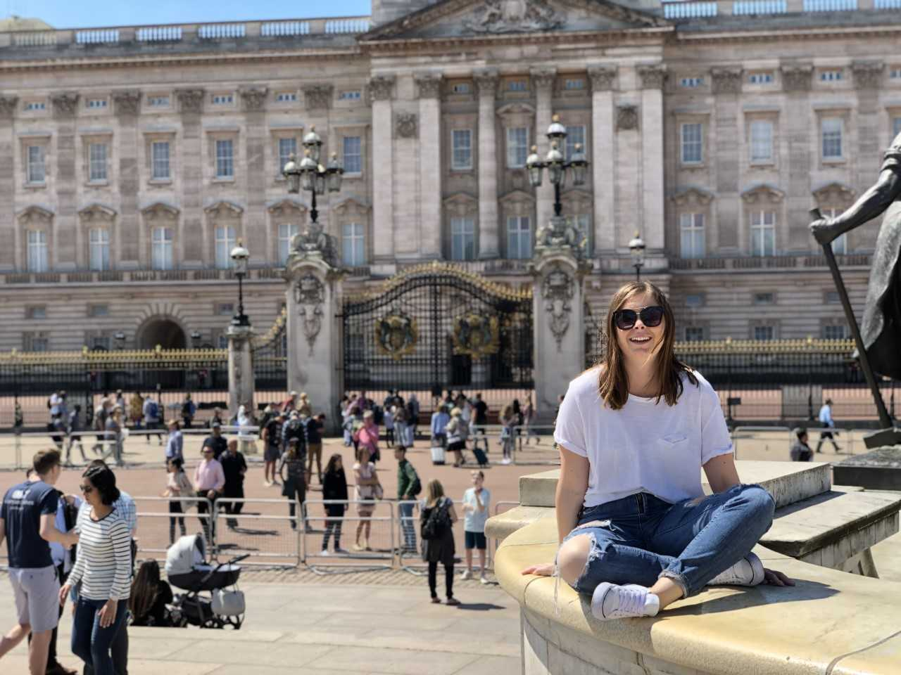
Who can study abroad?
Sophomore or higher
(>30 credit hours)
Minimum 2.5 GPA
Considered “good standing”
Notes:
These are the minimum requirements. Specific programs may have their own requirements.
IBP recommends studying abroad during your junior year, after earning admission into COB and completing the foundation courses (FIN 380, MGT 340, MKT 350)

Slide 4
Notes:
Of the 188,753 students in the U.S. who studied abroad for academic credit, 21% are business and management students. What this means for COB students is that there are plenty of business program and course options for you.

Slide 5
Where can I study abroad?
Notes:
In short – almost anywhere! Europe is the most popular, but we send students all over the world.

Slide 6
how can I study abroad?
Exchange Programs
In-state tuition, housing, and meals
Semester or academic year
Transfer credits back to MSU
Affiliate Programs
Pay program fee to provider
Homestays, apartments, student housing options
Transfer credits back to MSU
Semester, summer, academic year
Internship
Credit-bearing options
Get international experience in your field
Stand out on your resume
Independent Education Abroad Program
Study abroad through a partner/institution not listed on IBP/OEA website

Slide 7
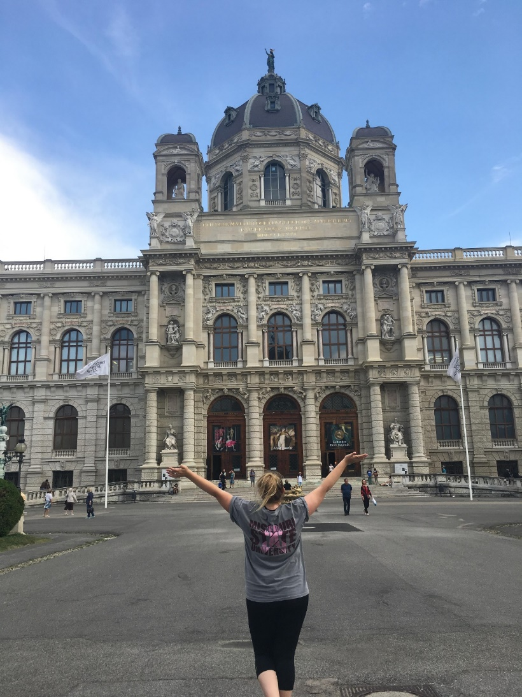
Magellan exchange
Pay Missouri in-state tuition
Classes transfer with an online preapproval system
Classes are taught in English
Notes:
COB works closely with the Magellan Exchange program. Mary Tomerlin is Missouri State University’s Magellan Coordinator and will help you through the process, along with the Magellan coordinator at your host institution.

Slide 8
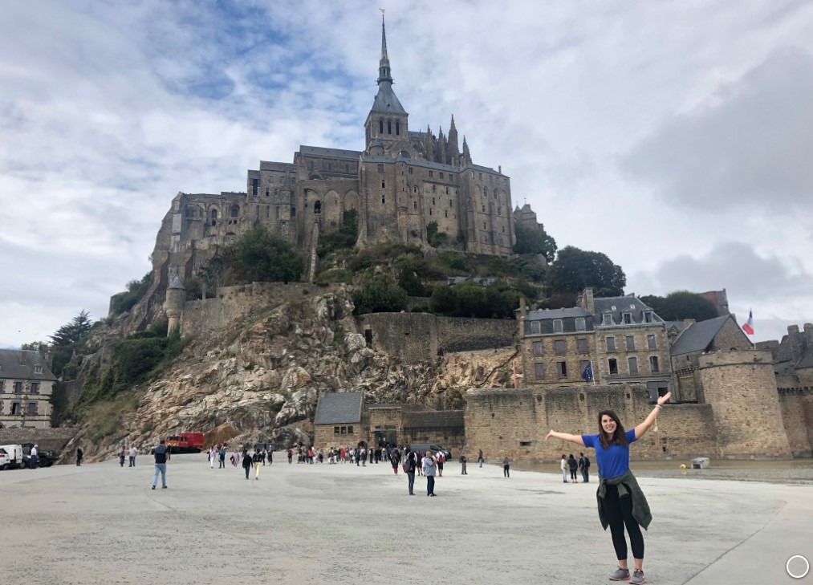
Magellan exchange
Fall, spring, summer, or
academic year
Austria France
Denmark Mexico
Germany Spain
Costa Rica Finland
The Netherlands Belgium
South Korea Serbia
United Kingdom
Notes:
We have 24 Magellan Exchange partners in 13 countries outside the U.S.
Students can participate in a semester, summer or full academic year exchange.

Slide 9
Financial aid
Financial aid & scholarships still apply
COB general and departmental scholarship available
COB students will receive a $750 financial award upon departure (if eligible)
Programs offer various scholarships
Notes:
Work with Financial Aid regarding requirements for your specific financial aid and scholarships.

Slide 10
when can I study abroad?
Notes:
STFD, summer, semester or academic year

Slide 11
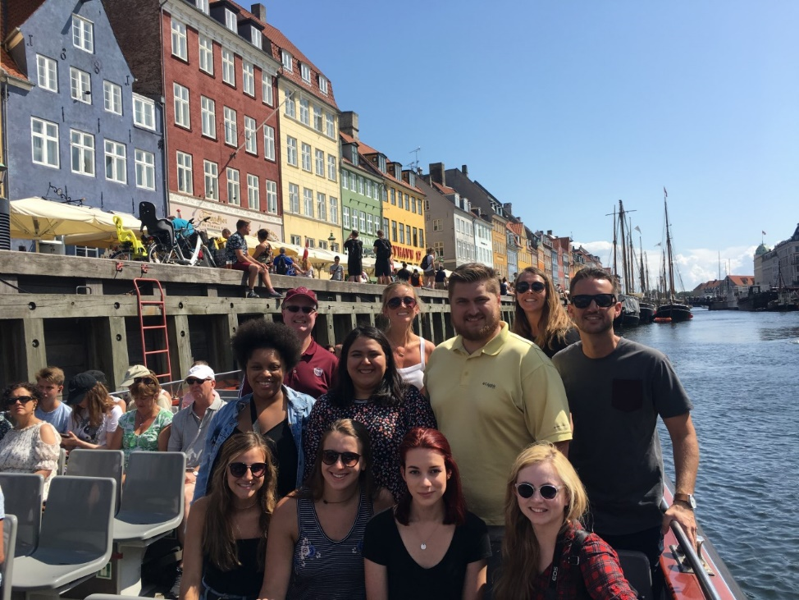
Short-term faculty-Directed
STFD Programs are six weeks or less
MSU faculty lead groups during the summer, intersessions, or spring break
Can be either domestic or international
Notes:
Usually 10 days or so, over spring break or summer/winter intersession.

Slide 12
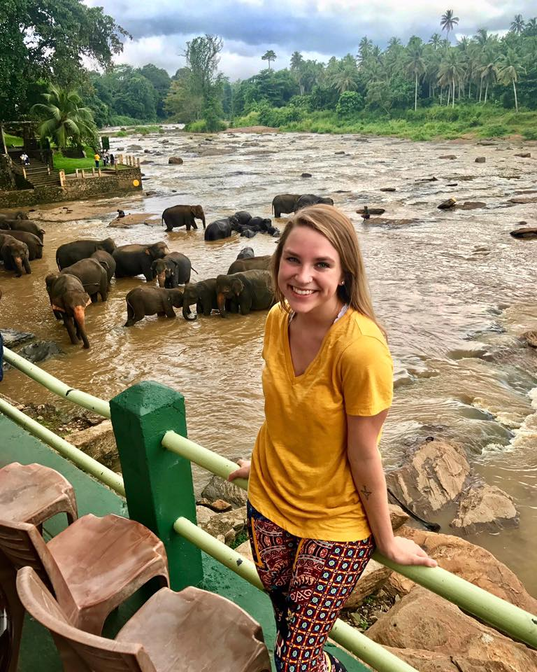
Short-term faculty-Directed
Spring
Ireland – Business, Technology, and Culture
Portugal, France, and the UK – Business and Culture
Berlin, Germany – East Meets West
Sicily, Malta, Italy – Art, Architecture, Landscapes
Fall
New York City Study
Notes:
Current options

Slide 13
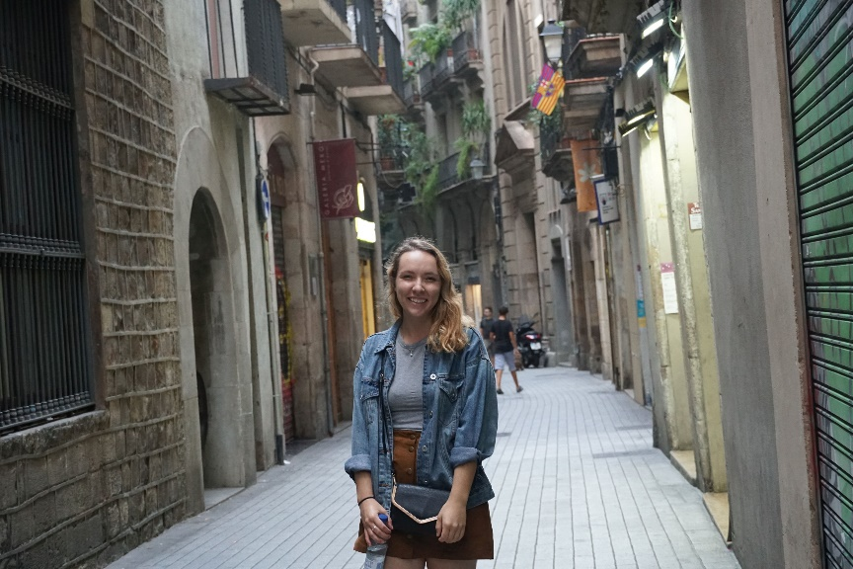
Deadlines
Spring Semester: November 1st
Summer/Fall Semester: April 1st
*Some programs (especially short-term/summer) have earlier deadlines.
Notes:
Apply before the deadline!

Slide 14
Who do I talk to about education abroad?
Education Abroad Fair
Wednesday, September 18, 2024
In the PSU
11am - 2pm
Gather information about programs that fit your academic & personal goals!
Talk with program representatives and faculty directors.

Slide 15
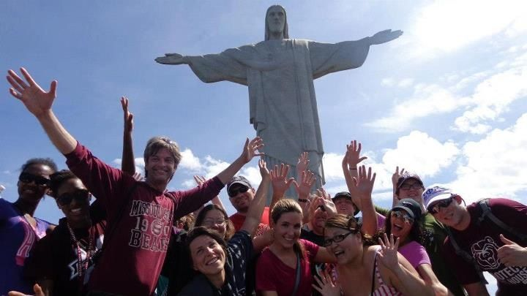
International business programs office
Visit us: Glass 103
Email: IBP@MissouriState.edu
Website: IBP.MissouriState.edu
Phone: 417-836-5874
Notes:
Call, email or stop by any time with questions.

