Slide 1
International Business Programs

Slide 2
Why study abroad?

Slide 3
Growth
Personal
Academic
Professional

Slide 4
short-term
program provider
summer
exchange
where do i start?
semester
internship
academic year
service learning
4

Slide 5
Short-Term Faculty Directed
1-2 weeks
Intersession, fall/spring break
Domestic or international
MSU course credit
MSU students
MSU faculty member

Slide 6
Summer
Semester
6-8 weeks
~16 weeks
transfer credits back to MSU
choose exchange, program provider, internship or service learning

Slide 7
Exchange
Pay Missouri in-state tuition
Culturally immersive experience
Classes taught in English
Credits transfer back to MSU
Program Provider
Pay fee to provider
Additional support
Extra experiential opportunities
Credits transfer back to MSU
Internship
Credit-bearing options
International experience in your field

Slide 8
Magellan Exchange
Austria
Belgium
Costa Rica
Denmark
Finland
France
Germany
Mexico
The Netherlands
Serbia
South Korea
Spain
United Kingdom
IBP assists with course credit transfer process

Slide 9
What about cost?

Slide 10
If you can afford a semester on campus, you can afford a semester abroad!
Find the right program
Know what your program fee covers
Exchanges tend to be more affordable
Work with IBP and Financial Aid

Slide 11
Financial Aid
Financial aid and scholarships still apply
COB Education Abroad Financial Award - $750
Board of Governors, Provost, Deans, and Inclusive Excellence - $1,000
COB general and departmental scholarships
MSU Foundation scholarships
External scholarships (Gilman, Boren, etc.)
Programs provider scholarships

Slide 12
Deadlines

Slide 13
Short Term
Summer 2025 – March 1st
January 2026 – October 1st
Spring Break 2026 – November 1st
Summer 2026 – December 1st
Long Term
Summer 2025 – April 1st
Fall 2025 – April 1st
Spring 2026 – November 1st
Don’t wait!
Some programs have earlier deadlines
11

Slide 14
Education Abroad Fair
September 2025
11

Slide 15
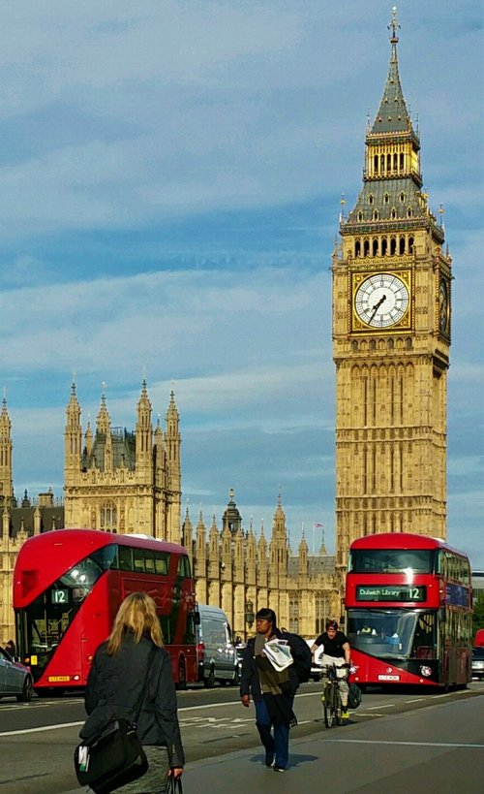
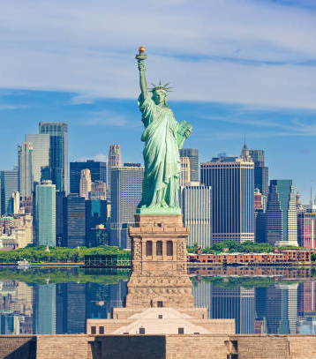
Upcoming Programs in 2025
Spring
Summer
Fall
Business Practices and Cultures
France – United Kingdom
East Meets West
Germany
Spirit of Europe
France – Belgium – Germany – Netherlands
The Baltic Chain
Finland – Estonia - Latvia - Lithuania
New York Study Away
New York City, New York
More Being Posted

Slide 16
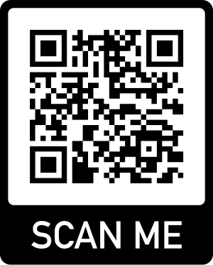
International Business Programs
Glass 103
IBP.MissouriState.edu
IBP@MissouriState.edu
417-836-5874

